Slide 1
Introduction
Session 1

Slide 2

Hi ! Everybody this is Dennish M.Ritchie

Slide 3
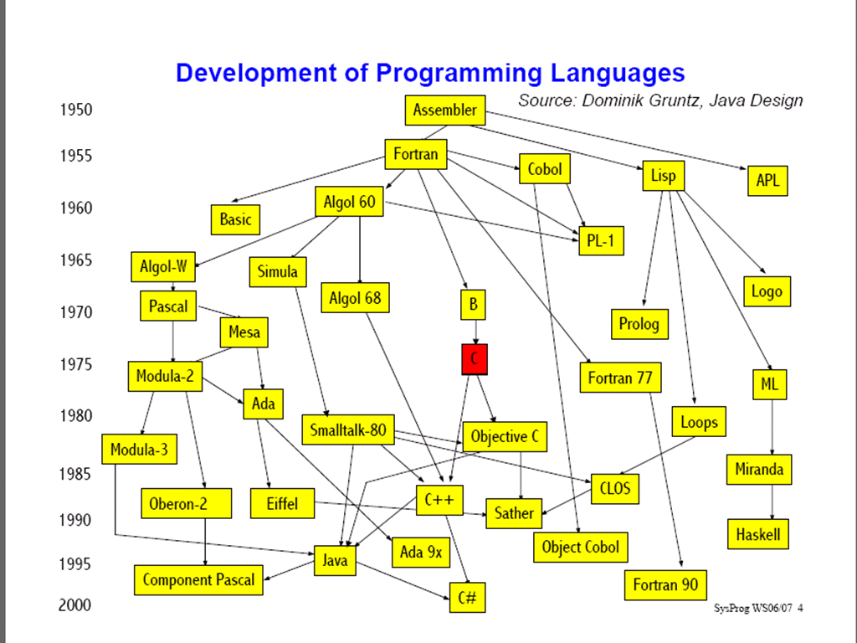

Slide 4
History
C – designed by Mr. Dennis Riche in the Bell Labs – in 1972.
Languages ALGOL, BCPL, stand as ancestors for this language.
Bussiness Common Programming Language
By Ken Thomson & Martin Richards
Later Modified By Dennis Richie
ALGOL
ALGOL
BCPL
BCPL
Algorithmic Language
The most traditional / ancient language
Almost Low Level In Nature
C

Slide 5
Features
Simple
Middle Level Language
Very less number of keywords only 32 in number
Block Structured
Pointers – a special highlight
Structures – First User Defined Data Types

Slide 6
Characteristics
Strictly case sensitive
Every program statement shall end with a (Semi Colon) ; - called the line terminator
Every compound statement shall be given with in the (flower braces) { } – called the de-limiters
Functions shall be followed by (parenthesis) ()

Slide 7
Tokens
Each symbol or word or any other indivisible part of a program is said to be a token.
Tokens for a programmatic language are – what parts of speech to a human langage are.
C provides the following tokens
  Keywords
  Operators
  Comments
  Identifiers
  Literals

Slide 8
Keywords
Keyword is a reserved word of a programmatic language, which intercept into a particular predefined task.
C has only 32 keywords, and they are…
auto | break | case | char | const | continue | default | do
double | else | enum | extern | float | for | goto | if
int | long | register | return | short | signed | sizeof | static
struct | switch | typedef | union | unsigned | void | volatile | while

Slide 9
Operators
Operator is a special symbol used to indicate a particular task.
Symbols like
  + for addition,
  - for substraction
  * for multiplication ..etc are a few examples
C is enriched with many operators and hence the number of keywords are less.
More about operators will be presented soon after a few more sessions.

Slide 10
Comments
Comment is a special non-instructional text. It is given in between the actual programmatic statements to provide necessary explanation.
The comment is of two types
  Single line
  Multi line
Single line comment starts with //
Multi line comment starts with /* and ends with */
Examples
  //this is a single line comment
  /* this is a multi line commetn, and is more than one line */

Slide 11
Identifiers
A user given name to variable, function, structure, union or enumeration ..etc, is called an identifier
Identifiers shall follow the below rules
  It can be alpha numeric, but should not start with a number
  It should not match with any keyword.
  It shall not contain spaces.
  It shall not contain any special characters like . , - ^ @ # $ ..etc but _ (underscore) is allowed
  It can be of any length.
  It can be in upper or lower or mixed case.

Slide 12
Identifier Examples
Valid Identifiers
  Length
  Student_name
  Car_number
  Marks1
  a
In Valid Identifiers
  Roll no contains space
  Sl.no contains special symbol . (perios)
  Sur-name contains special symbol – (hyphen)
  2b starts with a number 2
  A 5 contains space
  Char is a keyword

Slide 13
Literal
Any constant value embeded in a program is called a literal
Literals are classified as below
  Numeric
    Integer
      Decimal System
      Octal System
      Hexadecimal System
    Float
  Non Numeric
    Character
    String

Slide 14
Integer Literals
Any non fractional real number is a integer
C can identify integers in 3 different number systems
  Decimal System : digits {0,1,2,3,4,5,6,7,8,9}
  Octal System: digits {0,1,2,3,4,5,6,7}
  Hexadecimal System: digits {0,1,2,3,4,5,6,7,8,9,A,B,C,D,E,F}
Decimal System Integers are directly written with out any special symbols to identify. Eg: 10,15,42,91 ..etc.,
Octal System Integers should always precede with 0. Eg: 014, 01,05,021
Hexadecimal Integers always precede with 0x. Eg: 0x12,0xA1,0x5D ..etc
Most usally decimal system is only used.

Slide 15
Float Literals
Any fractional value is called a float.
The . (period) is used to separate the real part and fractional part in the float value
Eg:
  12.0
  9.08
  9.00008 ..etc
Remember that 12.0 and 12 may be equal in magnitude , but 12 is an integer and 12.0 is a float, thus computer differentiates between them.

Slide 16
Character Literals
Any single keyboard symbol is a character
A character should always be placed with in single quotes ‘ ’
Examples
  ‘a’ ‘1’ ‘0’ ‘#’ ‘@’ ‘A’ ‘z’ …etc
Remember the following are not the same
  ‘8’ is a character
  8 is a integer
  8.0 is a float

Slide 17
String Literals
Collection of characters is called a string
String are always enclosed between “ “ (double quotes)
Examples
  “a”
  “apple”
  “this is a sentence” …etc

